Slide 1
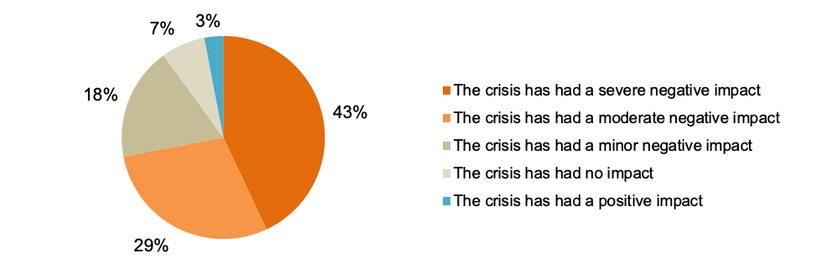
Figure 1
Negative Impacts of Covid 19 on Small Businesses
(Small Business Majority, 2020)

Slide 2
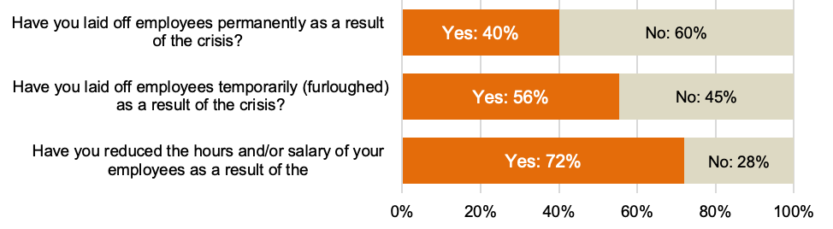
Figure 2
Widespread Reductions in Workforce
(Small Business Majority, 2020)

